Slide 1
SESSION 23
Attention Mechanism & Transformers
Every word looks at every other word — the idea that replaced recurrence
Attention(Q, K, V) = softmax(QKᵀ / √dₖ) V
Theory + Hands-on · ~1.5 hours · Computer Vision & AI Course
Notes:
Welcome to Session 23. Last session we ended with RNNs/LSTMs and hinted that attention was coming. Today: the single most important idea in modern AI. First half theory, second half we build attention from scratch in the notebook.

Slide 2
Today's Agenda
Roughly half theory (slides) and half hands-on (notebook)
PART 1 · THEORY
~45 minutes
PART 2 · HANDS-ON
~45 minutes · Jupyter notebook
Why RNNs weren't enough — the bottleneck
Attention intuition: what does “it” refer to?
Queries, Keys, Values step by step
Multi-head attention & positional encoding
The full Transformer architecture
BERT, GPT & the Transformer family
Compute attention scores by hand (NumPy)
Scaled dot-product attention in PyTorch
Build a multi-head attention module
Visualize attention weights as heatmaps
Peek inside a pretrained Transformer
Session 23 · Attention Mechanism & Transformers
2
Notes:
Set expectations: first half is concepts with visuals, second half we code every equation we see today. Nothing today is beyond matrix multiplication and softmax - both already familiar.

Slide 3
Where Session 22 Left Off
RNNs and LSTMs read one word at a time — and that causes three problems
1
2
3
Sequential = slow
Long-range forgetting
One-vector bottleneck
Word 50 can't be processed until words 1–49 are done. No parallelism — GPUs sit idle.
Even LSTMs struggle to connect words that are far apart. Information fades as it's passed along.
In seq2seq, the whole input is squeezed into a single hidden vector before decoding. Detail is lost.
The 2017 paper “Attention Is All You Need” asked: what if we drop recurrence entirely and let every word look at every other word directly?
Session 23 · Attention Mechanism & Transformers
3
Notes:
Quick recap of Session 22's cliffhanger. Emphasize: hidden state worked, but it is a relay race - information must survive being handed from word to word. Attention replaces the relay with direct connections.

Slide 4
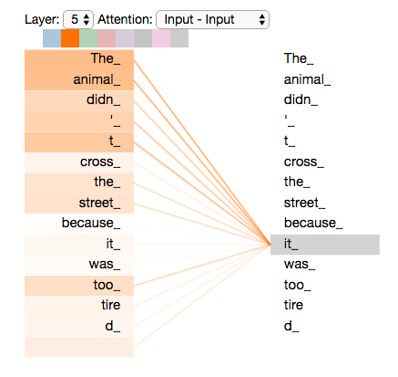
Attention: The Intuition
Let the model decide which words matter for understanding each word
“The animal didn't cross the street because it was too tired.”
What does “it” refer to — the street or the animal? Trivial for you, hard for a model.
Self-attention lets “it” look at every other word and assign each one a weight.
High weight on “animal” → its meaning is blended into the representation of “it”.
Every word does this simultaneously — no step-by-step reading, fully parallel.
Image: Jay Alammar, “The Illustrated Transformer” (CC BY-NC-SA 4.0)
Session 23 · Attention Mechanism & Transformers
4
Notes:
This is THE example to spend time on. The darker the line, the more attention. When encoding 'it', the model attends strongly to 'The animal'. Ask the client: how would an LSTM have to carry this information? Contrast with direct lookup.

Slide 5
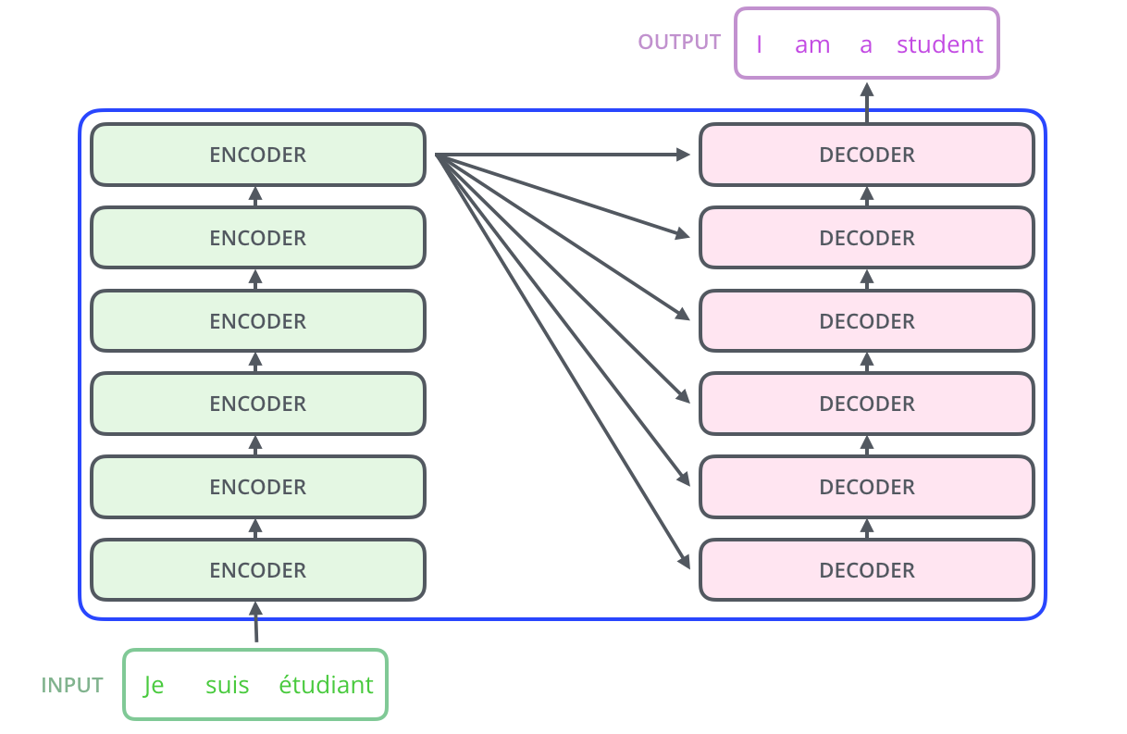
The Transformer at 30,000 Feet
An encoder stack that reads, a decoder stack that writes
Born for machine translation: sentence in → sentence out.
Encoder stack (×6): builds a rich, attention-aware representation of the input.
Decoder stack (×6): generates the output one word at a time, consulting the encoder.
No recurrence anywhere — all words are processed at once.
Six is not magic; it's just what the paper used.
Image: Jay Alammar, “The Illustrated Transformer” (CC BY-NC-SA 4.0)
Session 23 · Attention Mechanism & Transformers
5
Notes:
Keep this quick - it's a map, not the territory. The interesting machinery is inside each encoder box, which is where we go next.

Slide 6
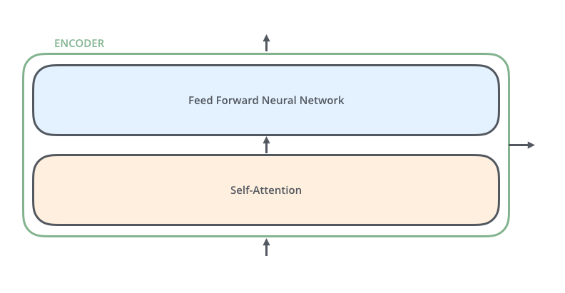
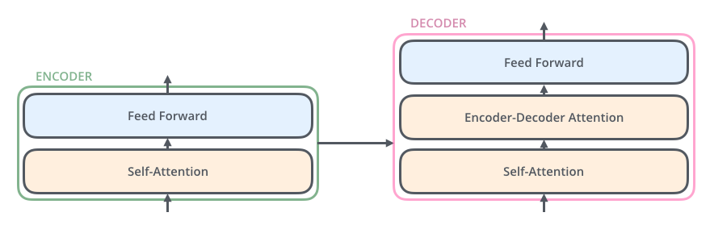
Inside One Encoder (and Decoder)
Two simple sub-layers, repeated — that's the whole trick
Encoder = self-attention + feed-forward network.
Self-attention: each word gathers context from all other words.
Feed-forward: the same small MLP applied to each position independently.
Decoder adds a third layer: encoder-decoder attention, so output words can look back at the input sentence.
Image: Jay Alammar, “The Illustrated Transformer” (CC BY-NC-SA 4.0)
Session 23 · Attention Mechanism & Transformers
6
Notes:
Point out the FFN is applied per position - it's the same network for every word, so it parallelizes perfectly. The only place words interact is the attention layer.

Slide 7
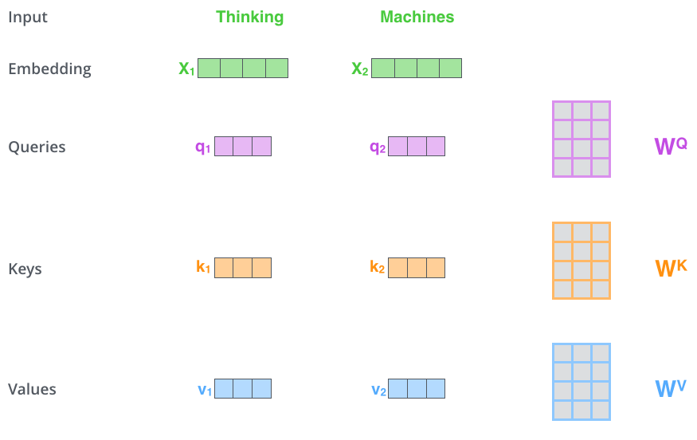
Queries, Keys & Values
Three learned projections of every word — think of a search engine
Query (q): “what am I looking for?” — the word doing the searching.
Key (k): “what do I contain?” — the label other words match against.
Value (v): “what do I actually pass on?” — the content that gets blended.
Each is just the embedding × a learned weight matrix (WQ, WK, WV).
Smaller than the embedding (64 vs 512) — a design choice for multi-head efficiency.
Image: Jay Alammar, “The Illustrated Transformer” (CC BY-NC-SA 4.0)
Session 23 · Attention Mechanism & Transformers
7
Notes:
Search-engine analogy: your query is matched against video titles/descriptions (keys), and what you get back is the videos themselves (values). The three W matrices are what training learns.

Slide 8
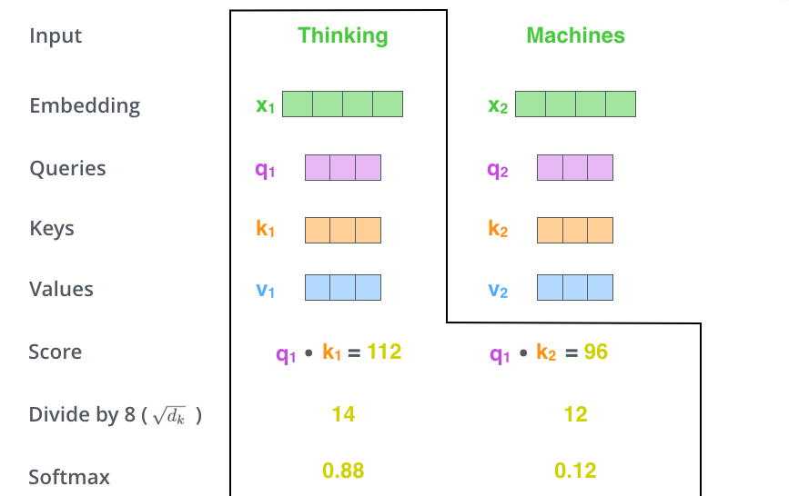
Step by Step: Score, Scale, Softmax
How much should “Thinking” attend to “Machines”?
Score: dot product q·k between the current word's query and every word's key.
Scale: divide by √dₖ (= 8 in the paper) to keep gradients stable.
Softmax: turn scores into positive weights that sum to 1.
Result: a probability-like weighting over the whole sentence for this word.
Image: Jay Alammar, “The Illustrated Transformer” (CC BY-NC-SA 4.0)
Session 23 · Attention Mechanism & Transformers
8
Notes:
Walk through the numbers in the figure: 112 and 96 become 14 and 12 after scaling, then 0.88 and 0.12 after softmax. That 0.88/0.12 split IS the attention.

Slide 9
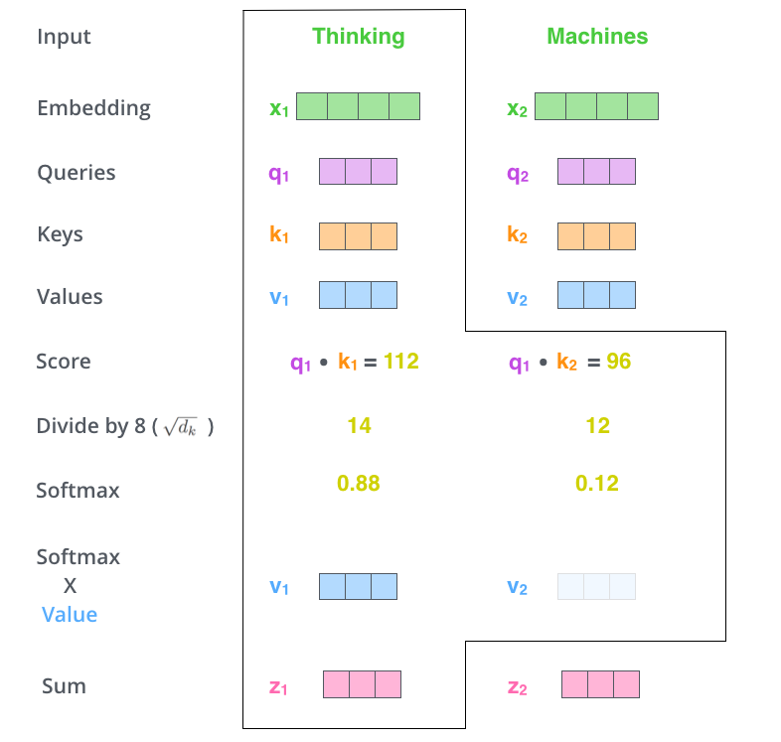
Step by Step: The Weighted Sum
Multiply each value by its weight, add them up — done
Multiply each word's value vector by its softmax weight.
Relevant words survive almost intact; irrelevant ones are drowned out (×0.001).
Sum the weighted values → z, the attention output for this position.
z now contains a context-aware mix: mostly this word, plus whatever it attended to.
Image: Jay Alammar, “The Illustrated Transformer” (CC BY-NC-SA 4.0)
Session 23 · Attention Mechanism & Transformers
9
Notes:
This is the payoff slide for the mechanics: attention output = weighted average of value vectors, with weights decided by query-key similarity. Say that sentence twice.

Slide 10
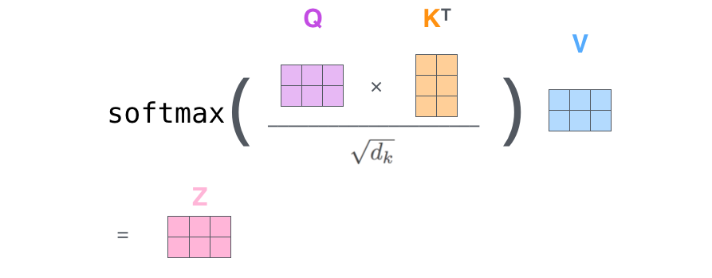
All Six Steps in One Formula
In practice it's a single matrix expression — fast and GPU-friendly
Image: Jay Alammar, “The Illustrated Transformer” (CC BY-NC-SA 4.0)
Rows of X = words. Pack embeddings into X, compute Q = X·WQ, K = X·WK, V = X·WV — the whole sentence is attended to in one shot.
Session 23 · Attention Mechanism & Transformers
10
Notes:
Connect to the notebook: this formula is literally 3 lines of PyTorch. scores = Q @ K.T / sqrt(dk); weights = softmax(scores); out = weights @ V. We'll write exactly this after the break.

Slide 11
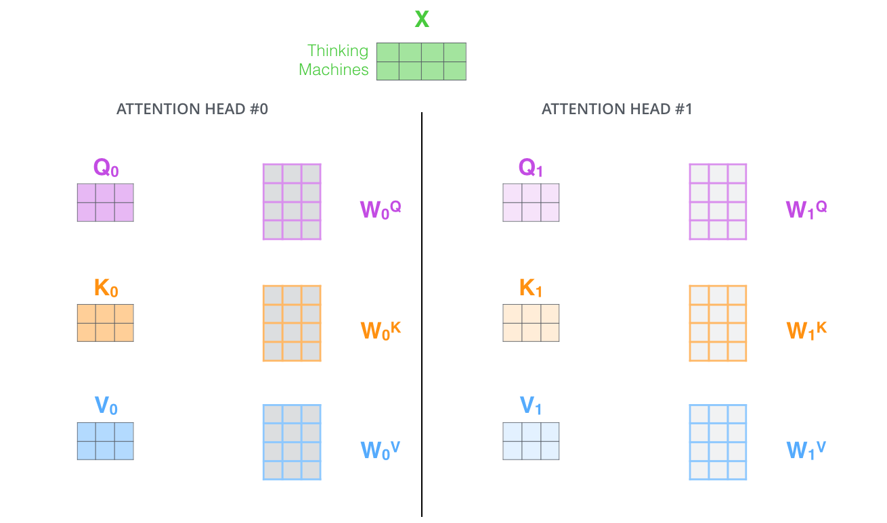
The Beast With Many Heads
Run attention 8 times in parallel, each with its own Q/K/V matrices
One head can be dominated by the word attending to itself.
Eight heads = eight “representation subspaces”, each learning a different relationship.
One head may track syntax (subject↔verb), another coreference (“it”↔“animal”).
Outputs are concatenated and projected back with WO to a single matrix.
Image: Jay Alammar, “The Illustrated Transformer” (CC BY-NC-SA 4.0)
Session 23 · Attention Mechanism & Transformers
11
Notes:
Analogy: eight specialists reading the same sentence, each highlighting different things, then pooling notes. Head count is a hyperparameter - GPT-3 uses 96.

Slide 12
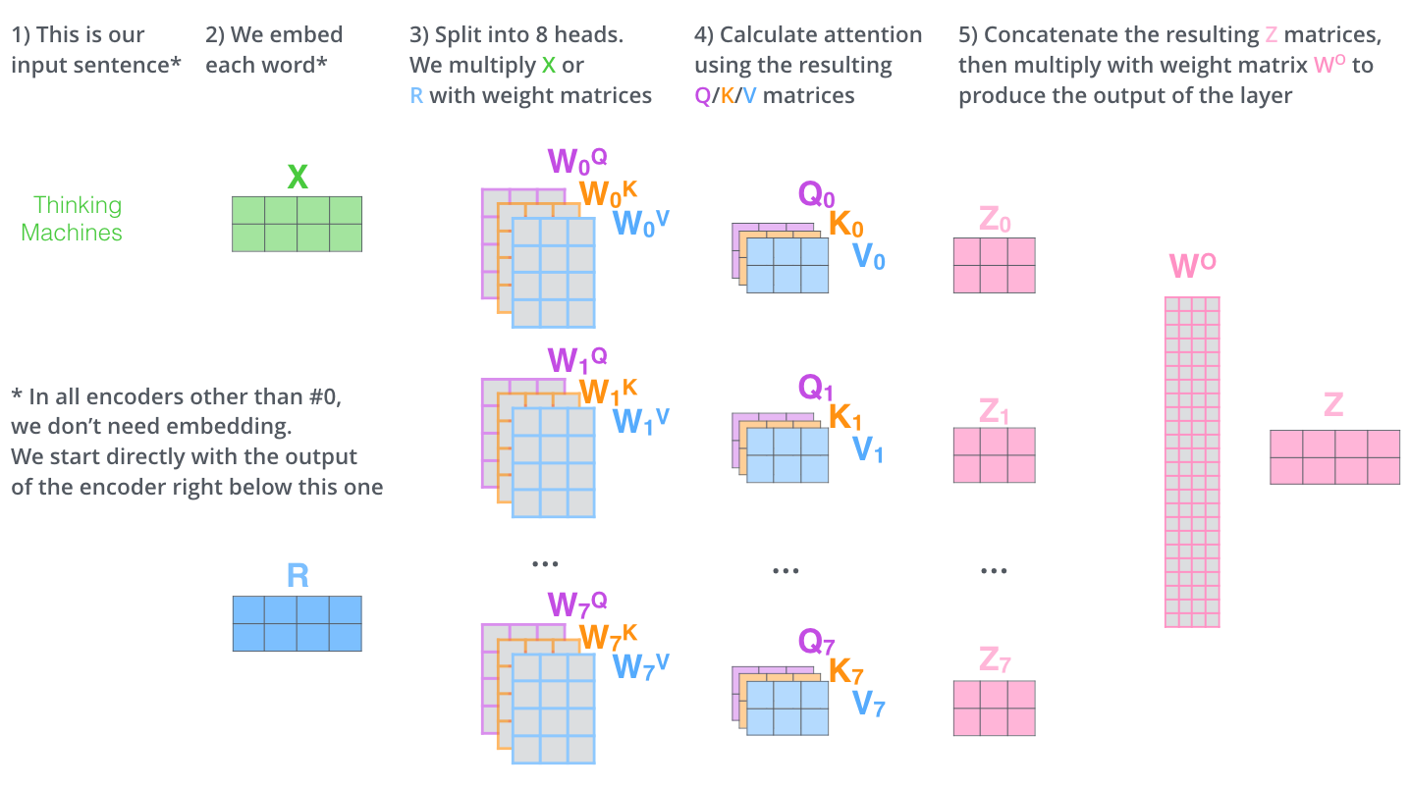
Multi-Head Attention: The Whole Pipeline
From raw sentence to attention output — every matrix in one picture
Image: Jay Alammar, “The Illustrated Transformer” (CC BY-NC-SA 4.0)
Session 23 · Attention Mechanism & Transformers
12
Notes:
Recap slide - trace left to right slowly: input sentence, embed, split into 8 heads, attention per head, concat, multiply by WO, single Z out. Pause here for questions before moving to positional encoding.

Slide 13
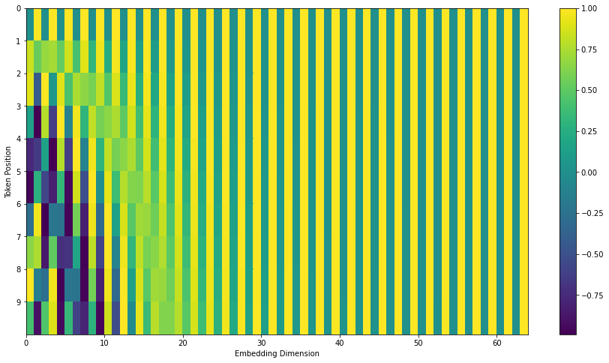
Positional Encoding
Attention has no idea about word order — so we add position to every embedding
“Dog bites man” vs “Man bites dog” — attention alone can't tell them apart!
Fix: add a position vector to each word embedding before the first encoder.
The paper uses fixed sine/cosine waves of different frequencies.
Bonus: generalizes to sentence lengths never seen in training.
Modern models often learn positions instead (or use RoPE).
Image: Jay Alammar, “The Illustrated Transformer” (CC BY-NC-SA 4.0)
Session 23 · Attention Mechanism & Transformers
13
Notes:
Key insight: self-attention is a set operation - permute the words, get permuted outputs. Order must be injected explicitly. Don't dwell on the sine formulas; the notebook has a heatmap visualization.

Slide 14
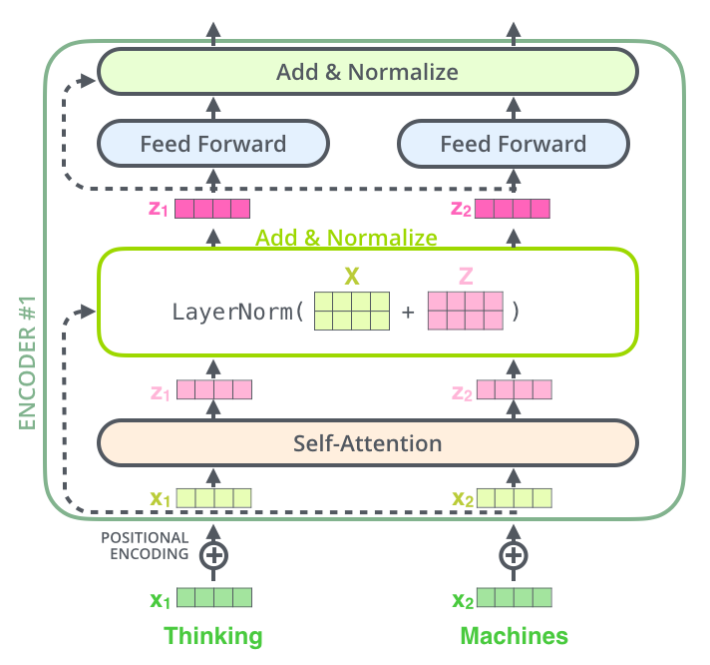
Residuals & Layer Normalization
The plumbing that lets us stack many layers without breaking training
Residual connection: each sub-layer's input is added to its output (x + Sublayer(x)).
Gradients get a “highway” straight through the network — same trick as ResNet in vision!
LayerNorm keeps activations in a healthy range after every sub-layer.
Pattern: Attention → Add & Norm → FFN → Add & Norm, repeated N times.
Image: Jay Alammar, “The Illustrated Transformer” (CC BY-NC-SA 4.0)
Session 23 · Attention Mechanism & Transformers
14
Notes:
Client already knows ResNet skip connections from the CV phase - lean on that. Nothing new conceptually, just applied to sequence layers.

Slide 15
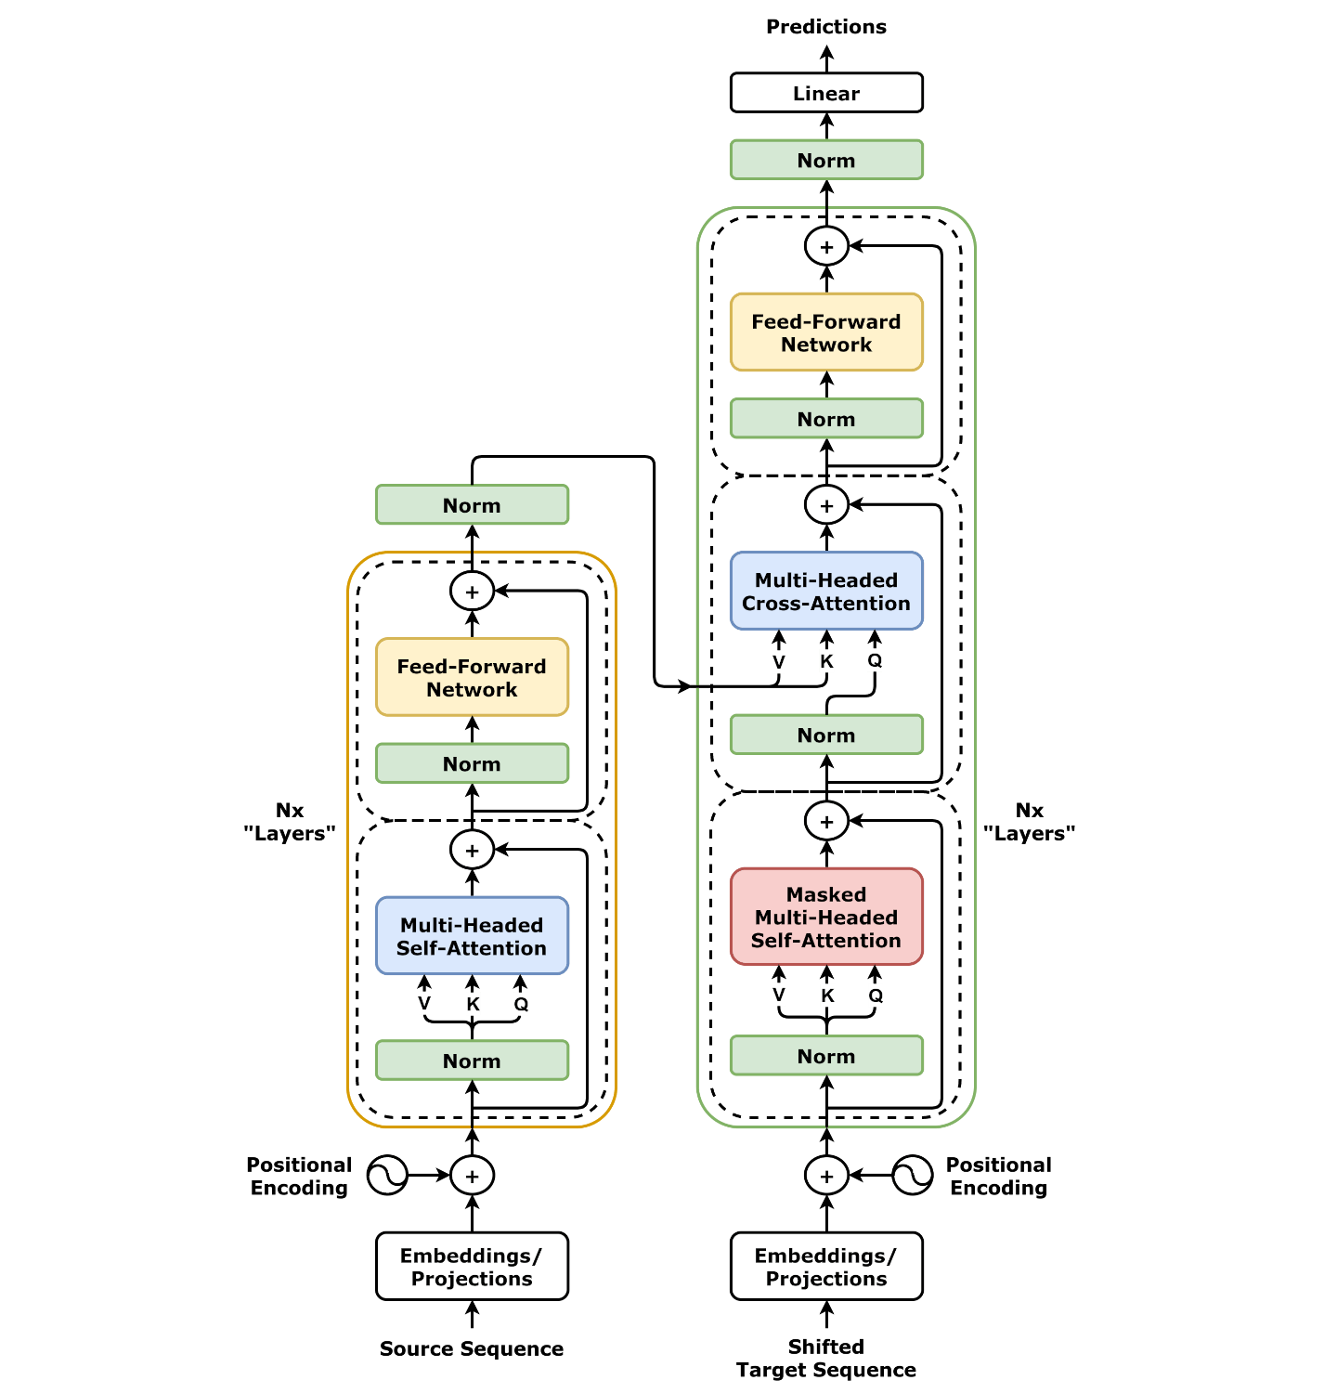
The Full Architecture
Everything we've built today, assembled — the famous Figure 1
Left tower: encoder — self-attention + FFN, ×N layers.
Right tower: decoder — with two twists:
Masked self-attention: the decoder may only look at words it has already produced.
Cross-attention: Q from the decoder, K & V from the encoder output.
Positional encoding enters at the bottom of both towers.
You can now read this entire diagram — every box is something we covered.
Image: Wikimedia Commons, after Vaswani et al. (2017), “Attention Is All You Need”
Session 23 · Attention Mechanism & Transformers
15
Notes:
Victory-lap slide: put up the full diagram and have the client explain it back to you box by box. The masking is why GPT can't see the future during generation.

Slide 16
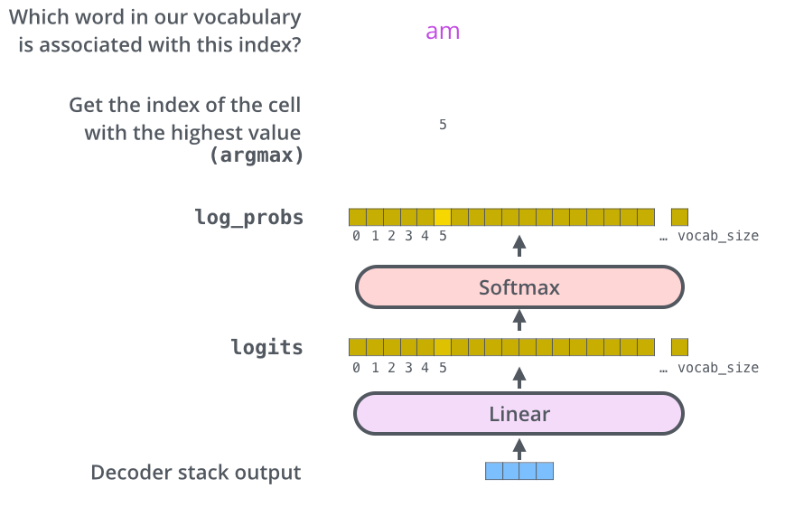
From Vectors Back to Words
The final linear + softmax layer turns the decoder output into a word
The decoder stack outputs one vector per position.
A linear layer projects it to vocabulary size (e.g. 30,000 logits).
Softmax converts logits into a probability for every word.
Pick the top word (greedy) or keep several candidates (beam search).
Generation repeats until an end-of-sentence token appears.
Image: Jay Alammar, “The Illustrated Transformer” (CC BY-NC-SA 4.0)
Session 23 · Attention Mechanism & Transformers
16
Notes:
Same output machinery as every classifier they've seen: logits then softmax, just with a 30k-class vocabulary. Training uses cross-entropy against the true next word.

Slide 17
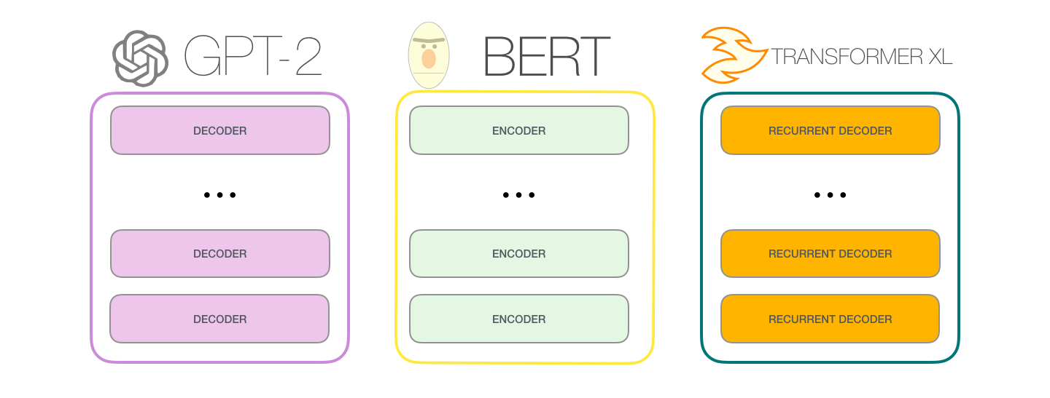
The Transformer Family
Pick your half of the architecture — and it scales to everything
Image: Jay Alammar, “The Illustrated GPT-2” (CC BY-NC-SA 4.0)
Encoder-only · BERT
Decoder-only · GPT
Same idea, images · ViT
Understanding: classification, search, NER
Generation: chat, code, modern LLMs
Patches = words → Transformers for vision (Session 27!)
Session 23 · Attention Mechanism & Transformers
17
Notes:
The 2017 architecture split into two family lines. BERT keeps the encoder (bidirectional, great at understanding); GPT keeps the decoder (causal, great at generating). ViT preview ties this back to the CV thread of the course.

Slide 18
Recap & What's Next
Six ideas to remember — then we go build them
Attention = weighted average of values, weights from query–key similarity.
Self-attention removes recurrence → fully parallel, direct long-range links.
Multiple heads capture multiple relationships at once.
Positional encodings inject word order.
Residuals + LayerNorm make deep stacks trainable.
Encoder-only (BERT), decoder-only (GPT) — one blueprint, all of modern AI.
UP NEXT · NOTEBOOK
Build scaled dot-product & multi-head attention from scratch in PyTorch, and visualize real attention maps.
GO DEEPER
“Attention Is All You Need” — Vaswani et al., 2017
“The Illustrated Transformer” — jalammar.github.io
Session 23 · Attention Mechanism & Transformers
18
Notes:
Close theory with the one-sentence summary: attention is a differentiable lookup table. Then switch to the notebook. Next session builds on this with the transformer architecture in code / ViT depending on the plan.

